Slide 1
Chapter 7 Sequential logic design principles
Latches and Flip-flops
Analysis of Synchronous Sequential Circuits
Design of Synchronous Sequential Circuits

Slide 2
Sequential Circuit
Sequential Circuit
– Output depends on current and previous inputs
– Hold/store previous information
storing bits or known information as states

Slide 3
Storing One Bit
Example Requiring Bit Storage
Flight attendant call button
  Press call: light turns on
    Stays on after button released
Call
button
1
Blue light
Bit
Storage
Cancel
button
  Press cancel: light turns off
    Stays off after button released
1. Call button pressed – light turns on
  Can combinational logic circuit implement this?
Call
button
Blue light
1
Bit
Storage
Cancel
button
2. Call button released – light stays on
Call
Q
Cancel
a
Call
button
0
Blue light
Doesn’t work. Q=1 when Call=1, but doesn’t stay 1 when Call returns to 0
Bit
Storage
Cancel
button
Need some form of “feedback” in the circuit
3. Cancel button pressed – light turns off

Slide 4
Latches（锁存器）

Slide 5
Bistable Elements
(双稳态元件)
1
0
0
Q
1
Q
1
QN
0
QN
0
1
Two Stable State:
Q = 1 or Q = 0
QN=0 or QN=1
When Power is first Applied to the circuit, it Randomly Comes up in One State or the Other and Stays there Forever.

Slide 6
Vin1 Vout1
Stable 稳定的
Q
Vout1
= Vin2
Metastable 亚稳稳定的
QN
Vin2 Vout2
Vin1
= Vout2
Vout2
Vin2
Vin2
Vout2

Slide 7
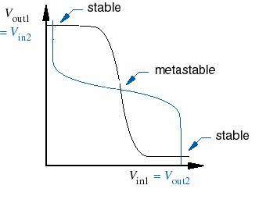
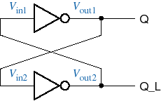
Metastability（亚稳态）
Metastability is inherent in any bistable circuit
Metastability can’t stay forever
5.0 V
2.5 V
4.8 V
2.51 V
2.5 V
2.0 V
0.1 V
QN
2.5 V
2.0 V
0.1 V
4.8 V
5.0 V
2.5 V

Slide 8
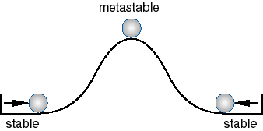
Another look at metastability
Even though Metastability can’t stay forever, but it would lead to an unknown stable state
Apply a definite Pulse Width from a Stable state to the Other
(从一个“稳态”转换到另一个“稳态”需加一定宽度的脉冲（足够的驱动）)

Slide 9
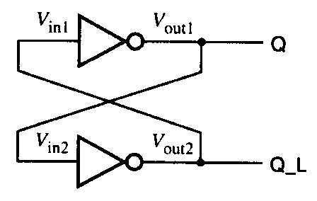
QN
State (Q) can be hold, but cannot be set !

Slide 10
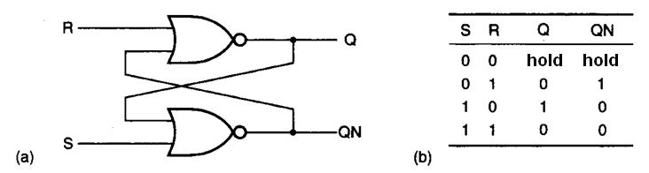
S-R latch
Symbol
when both S and R is (00), the state hold !
When SR=(10) Set: set Q = 1
When SR=(01) Reset: set Q = 0
S Q
R QN
S Q
R Q

Slide 11
Example Using SR Latch for Bit Storage
SR latch can serve as bit storage in previous example of flight-attendant call button
  Call=1 : set Q to 1
    Q stays 1 even after Call=0
  Cancel=1 : reset Q to 0
Blue lig
C
all
h
t
but
t
on
Bit
C
an
c
el
S
t
o
r
age
but
t
on
1
0
C
all
S
button
a
Blue lig
h
t
C
an
c
el
Q
1
button
R

Slide 12
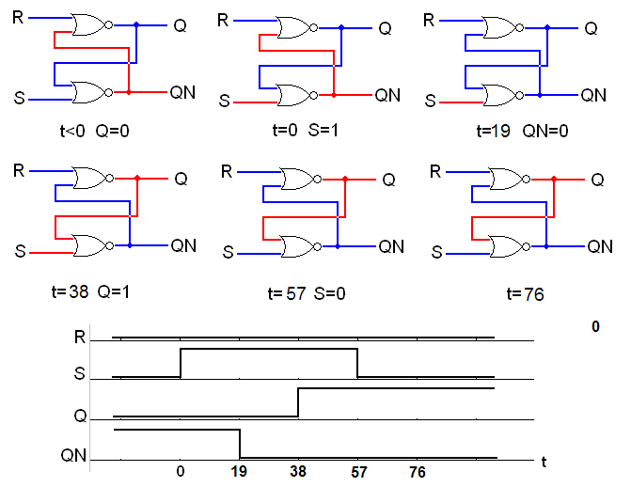
The time delay in S-R latch
Initial state:
Q=0
Last state:
Q=1
Assume:
delay of NOR is 19ns

Slide 13
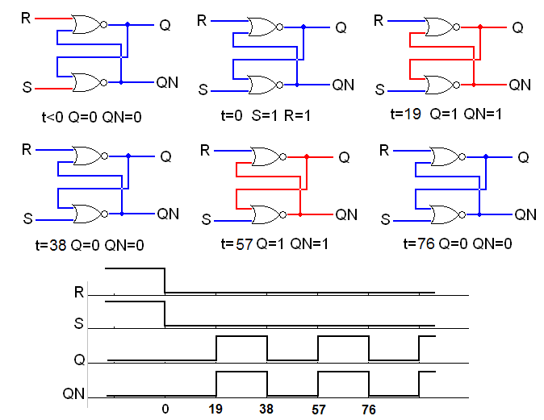
If input from 11 to 00
Initial state:
Q=0 QN=0
S=0 R=0
Last state:
Q=? QN=?
Metastable

Slide 14
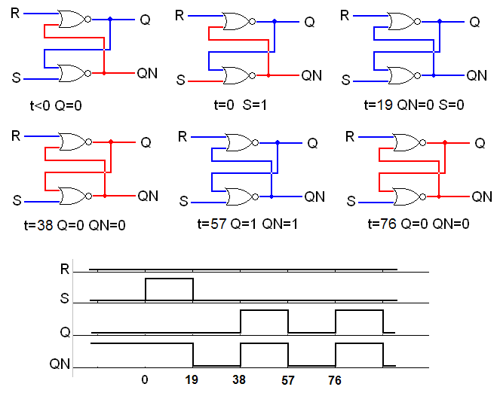
If input signal is too short
Initial state:
Q=0
Last state : metastable

Slide 15
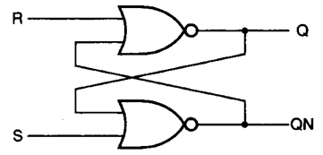
Summery of S-R latch
SR = 01 set 0 ;
SR = 10 set 1 ;
SR=11 and change to 00 simultaneously: metastable
SR = 00 hold : hold the state ; (But would hold an metastable state when spikes occur )
need a Minimum-pulse-width t_{pw(min)}

Slide 16

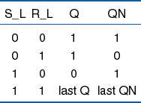
S’ – R’ Latch
S’
S_L
Q
R’
QN
R_L
symbol
S Q
R Q

Slide 17
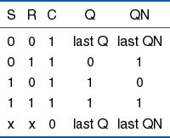
S-R Latch with enable
Use NAND gates to control the inputs
S
S_L
Q
C
QN
R
R_L
When C=0, both inputs are cut off ,
and the state is hold !
When C=1, it is a normal S-R latch;
S
C
R
Q
Q

Slide 18
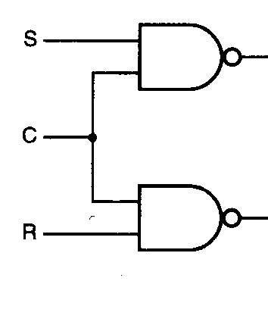
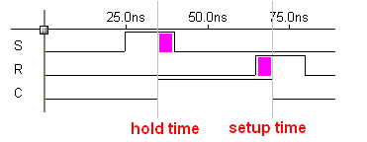
S-R latch with enable
The input pulse may be cut off by control signal !
Hold time: after the change of C 0→1 ;
Setup time: before the change of C 1→0 .

Slide 19
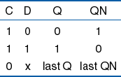
D latch
To avoid the inputs SR=11 and 00,
S and R is made complement !
symbol
S
D Q
C Q
D
Q
C
QN
R
When C=1, Q=D; when C=0, state hold !
The state is decided by the input Directly !

Slide 20
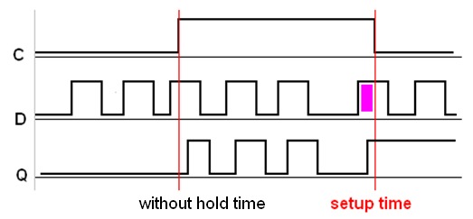
The time behavior of D latch
when C=1 , the metastable will never happen !
Only hold time and setup time should be considered !
hold time

Slide 21
Flip-flops（触发器）

Slide 22
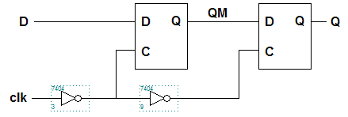
D flip-flop
Cascade of two D latches : master and slave;
They are enabled at complementary time !
master
slave
CLK=0, master enable, slave hold ; input come in ;
CLK=1, master hold, slave enable ; input cut off.

Slide 23
Time relations for DFF
t_{setup}: setup time
t_{hold}: hold time
t_{CQ}: propagation delay
CLK
t_{setup}
t_{hold}
D
QM
Q
t_{CQ}
The state changes only at the trigger time (rising edge of clock) !

Slide 24
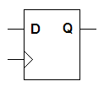
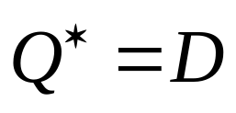
Characteristic equation of DFF
State outputs after trigger and is decided by data input before trigger;
（state changes at clock rising edge）
Edge-triggered

Slide 25
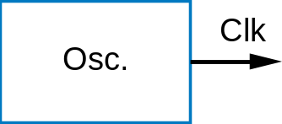
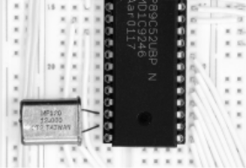
Clock Signal
Flip-flop Clk input typically connects to one clock signal
  Coming from an oscillator component
  Generates periodic pulsing signal
    Below: "Period" = 20 ns, "Frequency" = 1/20 ns = 50 MHz
    "Cycle" is duration of 1 period (20 ns); below shows 3.5 cycles
1
Clk
0
Time
:
0 ns
10 ns
20 ns
30 ns
40 ns
50 ns
60 ns
0
1
0
1
0
1
0

Slide 26

Control for DFF
D flip-flop with enable input
2 mux 1
D Q
EN
CLK Q
D
EN
D Q
CLK Q
Q
QN
CLK

Slide 27
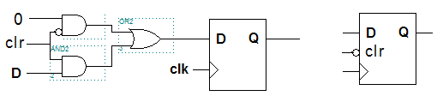

Control for DFF
D flip-flop with clear control

Slide 28
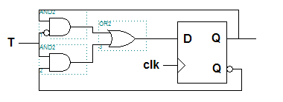

Control for DFF
T(toggle) flip-flop with enable
EN
EN Q
T
T Q
Q* = EN·Q’ + EN’·Q

Slide 29
T（toggle）Flip-flop
Q
Q
Q* = Q’
T

Slide 30
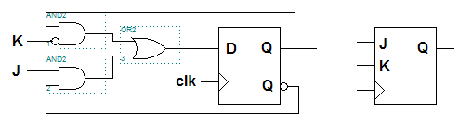
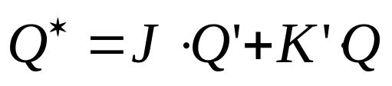
Control for DFF
JK flip-flop

Slide 31
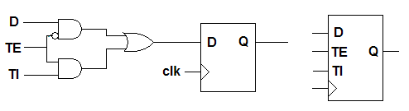
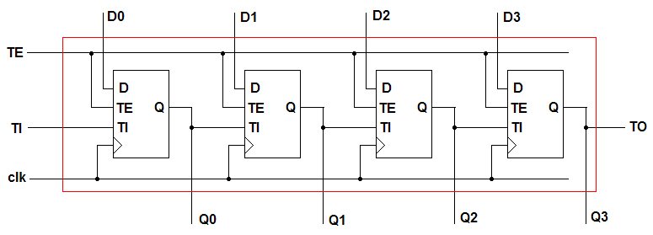
Control for DFF
Scan flip-flop and test chain
Figure 7-22, 23 P.544

Slide 32
Types of register
Latch: the inputs be watched continuously and output may be changed at any time;
Flip-flop: the input be sampled and output may be changed only at the times determined by the clock !

Slide 33
D latch
——电平有效
C
D
Q
CLK
D
Q
D filp-flop —— 边沿有效

Slide 34
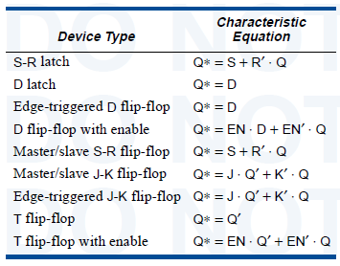

Slide 35
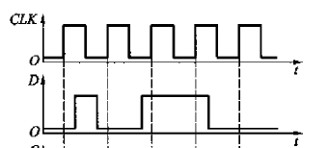
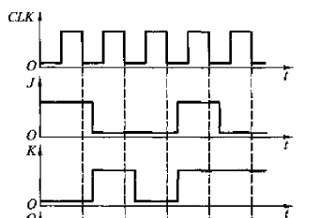
Questions
According the input waves, draw the output waves of different Flip-Flops (assume the initial state of Q=0, not considering propagation delay )
D
CLK
J
K
CLK

Slide 36
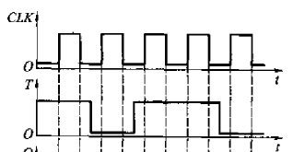
T
CLK
EN Q
T Q

Slide 37
Chapter 7 Sequential logic design principles
Synchronous design and FSM

Slide 38
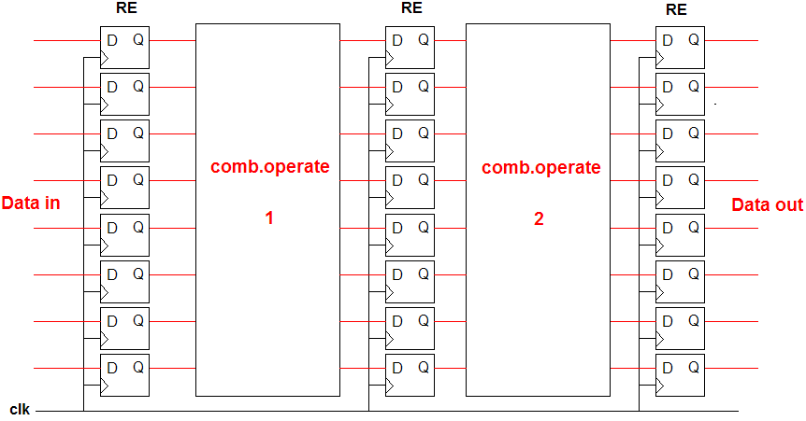
Register and pipeline design

Slide 39
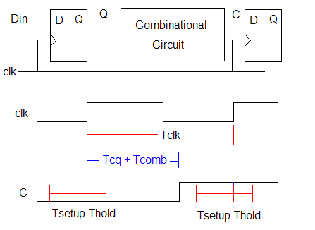
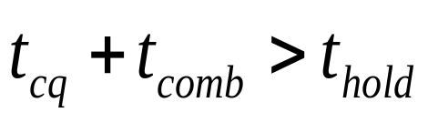
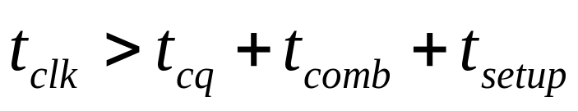
Time relations in synchronous design
Hold time margin：
Setup time margin：

Slide 40
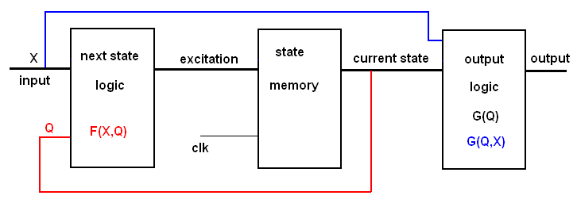
Finite state machine
Moore machine: output relies on states only
Mealy machine: output relies on states and inputs

Slide 41
Functions in FSM
Output function: G (Q) or G (X, Q)
Excitation function: F (X,Q)
Transition function: Q* (X, Q)
Variables: states , inputs
Each function can be represented by:
logic diagram , equation , table !

Slide 42
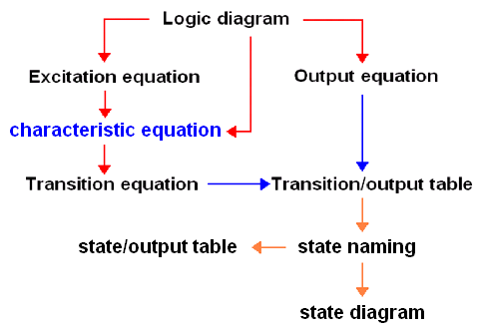
Analysis steps of FSM

Slide 43
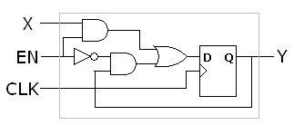


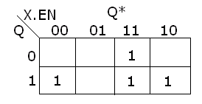

Examples for analysis
A D flip-flop with enable control
Output equation:
Excitation equation:
Characteristic equation: Q*= D
Y
Transition equation:
1
1
1
1
(simple 2-D table)

Slide 44
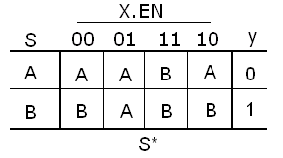

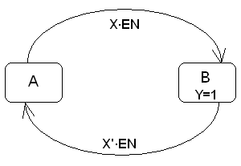
Examples for analysis
State naming
State/output table
State diagram
(For simplification, only indicate the transition to different state)

Slide 45
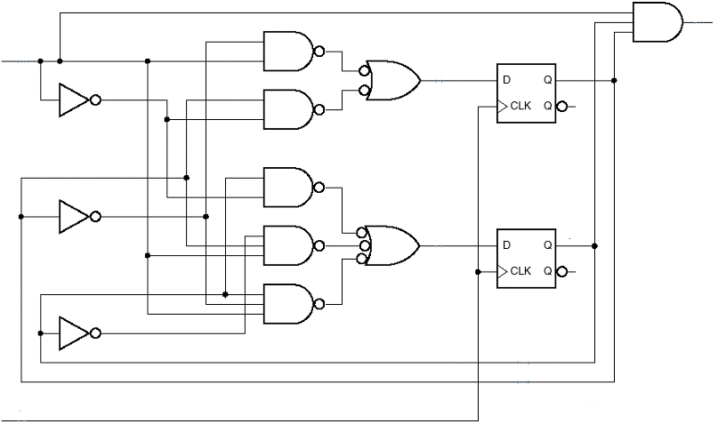
Examples for analysis
Next state logic F
State Memory
Output logic G
MAX
EN
output
EN
D0
Q0
Input
EN’
Q0
Q0’
D1
Q1
Q1
Q1’
Excitation
CLK
Current state

Slide 46
MAX
EN
3、Transition equations
Q* = D （D flip-flop)
Q0* = Q0·EN’ + Q0’·EN
Q1* = Q1·EN’ + Q1’·Q0·EN
+ Q1·Q0’·EN
Q0
EN
D0
EN’
Q0
Q0’
D1
Q1
Q1
Q1’
CLK
2、output equation
MAX = Q1·Q0·EN
1、Excitation equations
D0 = Q0·EN’ + Q0’·EN
D1 = Q1·EN’ + Q1’·Q0·EN + Q1·Q0’·EN

Slide 47
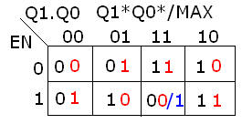
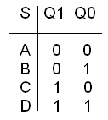
Examples for analysis
Transition/output table
EN
0 1
Q1Q0
0 0
0 1
1 0
1 1
00, 0
01, 0
10, 0
11, 0
01, 0
10, 0
11, 0
00, 1
State /output table
EN
0 1
S
Q1*Q0*, MAX
A
B
C
D
A,0
B,0
C,0
D,0
B,0
C,0
D,0
A,1
State naming
S*, MAX

Slide 48
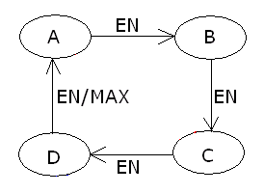
Examples for analysis
State diagram
Logic function
A mode-4 counter with an enable input and a Mealy output.

Slide 49
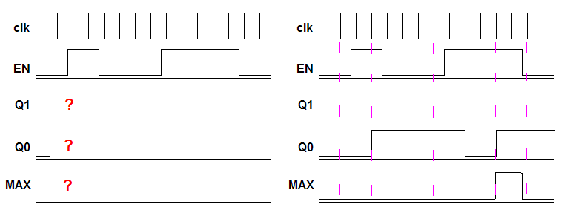
Examples for analysis
How to fulfill the timing diagram

Slide 50
Moore state machine
MAXS
MAX
EN
EN
D0
Q0
EN’
MAXS
=Q1·Q0
Q0
Q0’
D1
Q1
Q1
Q1’
CLK

Slide 51
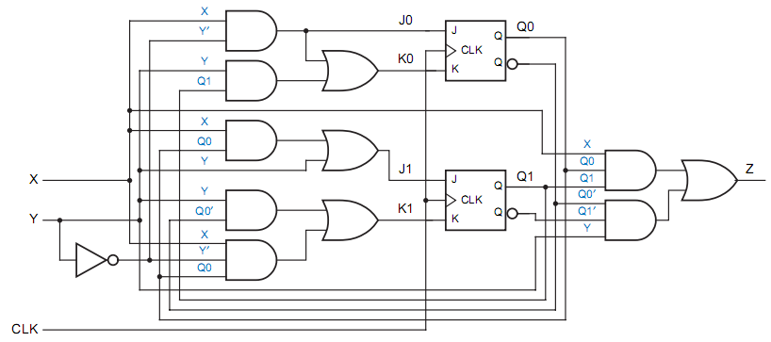
Question
Analyzing the FSM

Slide 52






Slide 53

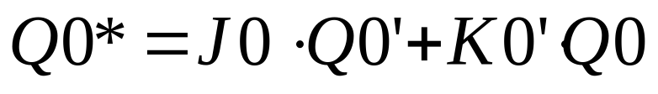
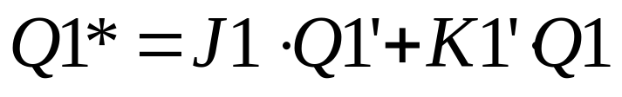
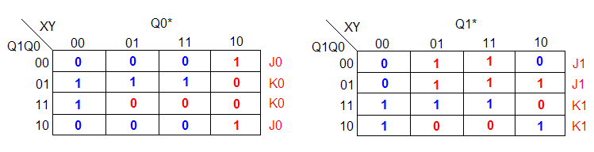

Slide 54
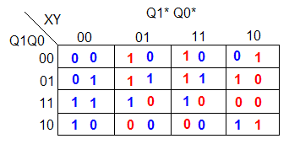


Slide 55
Chapter 7 Sequential logic design principles
FSM design: Counter

Slide 56

State-machine design

Slide 57


Design of Counters
A Moore machine with single state circle.
Q: states output; RCO: last state .

Slide 58


A mode 5 counter design
state diagram
state/output table
CO

Slide 59
A mode 5 counter design
State assignment
binary code Gray code
S0 0 0 0 0 0 0
S1 0 0 1 0 0 1
S2 0 1 0 0 1 1
S3 0 1 1 0 1 0
S4 1 0 0 1 1 0
Q2 Q1 Q0 Q2 Q1 Q0

Slide 60
A mode 5 counter design
Some guidelines for state assignment
The code for initial state should be easily reset;
The code for most used state should be simplest;
The code for neighboring state should be neighboring.

Slide 61


Construct the transition/output table
binary code
Gray code

Slide 62





Minimize the logic equations (1)
Excitation table for binary code
Minimal risk design
Choosing D flip-flop
D2D1D0/CO
/0
/0
/0

Slide 63

Minimal circuit of mode 5 counter(1)
minimal risk

Slide 64




Minimize the logic equations(2)
Excitation table for binary code
Minimal cost design
D2D1D0/CO
/d
/d
/d

Slide 65

Minimal circuit of mode 5 counter(2)
minimal cost

Slide 66




Minimize the logic equations(2)
The risk check for minimal cost design: Get the full states transition
Self-starting or self-recovery:
System will return to valid state from invalid state automatically

Slide 67
说明：
最小风险法(minimal risk)
所有未用状态的下一状态 置为“安全”状态，
即已用的有效状态
最小成本(代价)法(minimal cost)
所有未用状态的下一状态作为无关项
电路的激励方程简单，不够安全，需要检查
是否有自启动能力

Slide 68



Sequential logic design example
Design a generator for the periodic sequence (10110） as the clk triggered.
The state diagram
The state/output table

Slide 69


A generator for the periodic sequence
Use binary code , minimal cost design
Output table
d
d
d
Output equation

Slide 70

A generator for the periodic sequence
logic diagram

Slide 71


A generator for the periodic sequence
The other way to design the circuit:
Change the state assignment for S0, save the output equation

Slide 72

A generator for the periodic sequence
The other way to design the circuit:

Slide 73
Question
Minimal cost design with Gray code assignment

Slide 74
Chapter 7 Sequential logic design principles
FSM design: Sequence detector

Slide 75

Sequence detector design
Design a combination lock:
UNLOCK: X is 0 and preceding sequence was 0110111.
HINT: X is correct in any bit of the sequence 01101110.

Slide 76


Sequence detector design
Sequence detector :
Output 1 only when input sequence be 0110 1110
Mealy machine

Slide 77
Sequence detector design
Step 1: set up enough state with different meanings ;
State name state meaning
A 000 initial state, got no correct input;
B 001 got 0
C 010 got 01
D 011 got 011
E 100 got 0110
F 101 got 01101
G 110 got 011011
H 111 got 0110111

Slide 78

Sequence detector design
Step 2: set up the state diagram with correct input sequence ;

Slide 79

Sequence detector design
Step 3: finish the state diagram with incorrect input sequence ;

Slide 80
Sequence detector design
Step 4: from the state diagram to the state/output table;
S*，UNLK HINT，
X
State meaning
0
1
A
B，0，1
A，0，0
initial
B
B，0，0
C，0，1
0
C
B，0，0
D，0，1
01
D
E，0，1
A，0，0
011
E
B，0，0
F，0，1
0110
F
B，0，0
G，0，1
01101
G
E，0，0
H，0，1
011011
H
A，1，1
A，0，0
0110111

Slide 81


Sequence detector design
Step 5: State assignment for the state diagram and the transition/output table;
11

Slide 82

Sequence detector design
Sequence detector : one number 0110 1100 is detected on x.
Y1:mealy-type without overlapping
Y2:moore-type without overlapping
Y3:mealy-type with overlapping
Y4:moore-type with overlapping

Slide 83
Sequence detector design
A initial state;
B got 0
C got 01
D got 011
E got 0110
F got 01101
G got 011011
H got 0110110
I got 01101100

Slide 84


Sequence detector design
Y1:
Mealy machine
Y2:
Moore machine

Slide 85


Sequence detector design
Y3:
Mealy machine
Y4:
Moore machine

Slide 86

Sequence detector design
Sequence detector :
more than one number are detected
0110 , 1100
Y1:moore-type without overlapping
Y2:moore-type with overlapping

Slide 87
Sequence detector design
Considering the moore-type without overlapping
A initial state;
B got 0
C got 1
D got 01
E got 11
F got 011
G got 110
H got 0110 Y=1
I got 1100 Y=1

Slide 88

Sequence detector design
A initial state
B got 0
C got 1
D got 01
E got 11
F got 011
G got 110
H got 0110 Y=1
I got 1100 Y=1

Slide 89
Sequence detector design
A initial state
B got 0
C got 1
D got 01
E got 11
F got 011
G got 110
H got 0110 or 1100 , Y=1

Slide 90
States analyze examples
Key point for state: output , transition
Equivalent state:
the current output is the same;
the transition states is the same on same inputs;
The equivalent states should be replaced by a single state !

Slide 91
Chapter 7 Sequential logic design principles
State optimize and transition list

Slide 92

Sequence detector design
Design a “simple state machine ”:
The output Z should be 1 if :
A had the same value at each of the two previous clock ticks or B has been 1 since last Z was 1.

Slide 93
P555
1 2 3 4 5 6 7 8 9 10 11
CLK
A
B
Z

Slide 94
Sequence detector design
State name state meaning
S0 initial state;
S1 A=0;
S2 A=1;
S3 A=00; Z=1;
S4 A=11; Z=1;
S5 A=01; Z=1;(B=1)
S6 A=01; Z=0;
S7 A=10; Z=1;(B=1)
S8 A=10; Z=0;

Slide 95

Sequence detector design
State / output table

Slide 96
Sequence detector design
Equivalent states pairs:
S5—S4 S6—S2 S7—S3 S8—S1
S*
AB
Z
S
00
01
11
10
The minimal
state/output table
S0
S1
S1
S2
S2
0
S1
S3
S3
S2
S2
0
S2
S1
S1
S4
S4
0
S3
S3
S3
S4
S2
1
S4
S1
S3
S4
S4
1

Slide 97

Sequence detector design
The minimal state diagram

Slide 98


Sequence detector design
State assignment
Use decomposed assignment, output is Q2;

Slide 99


Transition list and minimization

Slide 100




Transition list and minimization (minimal cost)

Slide 101

Examples : T-bird tail lights control
input：L (turn left)、R (turn right)、H (emergency-
flasher）、CLOCK
output：six lights (LC,LB,LA,RA,RB,RC)
Hazard
Turn
right
Turn
left
LC
LB
LA
RA
RB
RC

Slide 102

Examples : T-bird tail lights control
Step 1: set up enough state with different meaning ;
State name state meaning
IDLE all lights are off ;
L1 one left light is on;
L2 two left lights are on;
L3 three left lights are on;
R1 one rignt light is on;
R2 two right lights are on;
R3 three right lights are on;
LR3 all lights are on ;

Slide 103


Examples : T-bird tail lights control
Step 2-3: from state diagram to the transition list

Slide 104

Examples : T-bird tail lights control
Step 4: from the transition list to the transition table

Slide 105




Examples : T-bird tail lights control
Step 5: get the excite equations for D flip-flop

Slide 106

Examples : T-bird tail lights control
Output table (Moore machine)

Slide 107

Register design
module latch (d,c,q);
input d,c;
output q;
assign q = (c ? d:q);
endmodule

Slide 108

Always block and Variable
…
reg[7:0] f ;
…
always @ (posedge clk)
begin
variable assignment;
end
Variable: must be reg , assigned in always block !

Slide 109
Always block and Variable
Variable:
Operational result , must be reg , may be stored in register, assigned in always block.
Nonblocking assignment: sequential design
f <= x & y;
Blocking assignment: combinational design
f = x & y;

Slide 110


Register design
module dff (clk,d,q,qn);
input clk,d;
output q,qn;
reg q,qn;
always @ (posedge clk)
begin q <= d ; end
always @ (q)
begin qn = ~q; end
endmodule

Slide 111

Register design
module reg8 (clk,clr,d,q);
input clk,clr;
input[7:0] d;
output[7:0] q;
reg[7:0] q;
always @ (posedge clk) begin
if (clr==1‘b1) q<= 8‘b00000000;
else q<= d; end
endmodule

Slide 112

FSM design: Behavioral description
module fsm (clk,a,b,z);
input clk,a,b;
output z;
reg z;
reg[2:0] state, snext;

Slide 113

State assignment
parameter[2:0]
init = 3'b000,
a0 = 3'b100,
a1 = 3'b101,
ok0 = 3'b110,
ok1 = 3'b111;

Slide 114
State transition: next state logic
always @ (a or b or state)
begin
case (state)
init: if (a==0) snext=a0;
else snext=a1;
a0: if (a==0) snext=ok0;
else snext=a1;
a1: if (a==0) snext=a0;
else snext=ok1;

Slide 115
State transition: next state logic
ok0: if (a==0) snext=ok0;
else if ((a==1) & (b==0)) snext=a1;
else snext=ok1;
ok1: if (a==1) snext=ok1;
else if ((a==0) & (b==0)) snext=a0;
else snext=ok0;
default: snext=init;
endcase
end

Slide 116
State memory and Output
always @ (posedge clk)
begin state<= snext; end
always @ (state) begin
case (state)
init,a0,a1: z=0;
ok0,ok1: z=1;
default z=0;
endcase
end
endmodule

Slide 117
Summary of Chap 7
Bistable element
metastability
Latches and Flip-flops
S-R latch, D latch
D flip-flop, J-K flip-flop, T flip-flop
Analysis of Synchronous Sequential Circuits
Design of Synchronous Sequential Circuits

Slide 118
Homework
7.4
7.5
7.6
7.7
7.8
7.12
7.18
7.20
7.21(a)(b)(c)
7.24
7.44
7.46
7.54

